Slide 1

01
Created by
Manish Walurkar
Predictive
Maintenance
using Machine Learning models
www.github.com/Manish-128

Slide 2

02
Problem Statemet
03
Objectives & Goals
03
Importance of PdM
03
Agenda
Flow of Project
03
Model Training
03
Model Evaluation
03
Conclusion
03

Slide 3
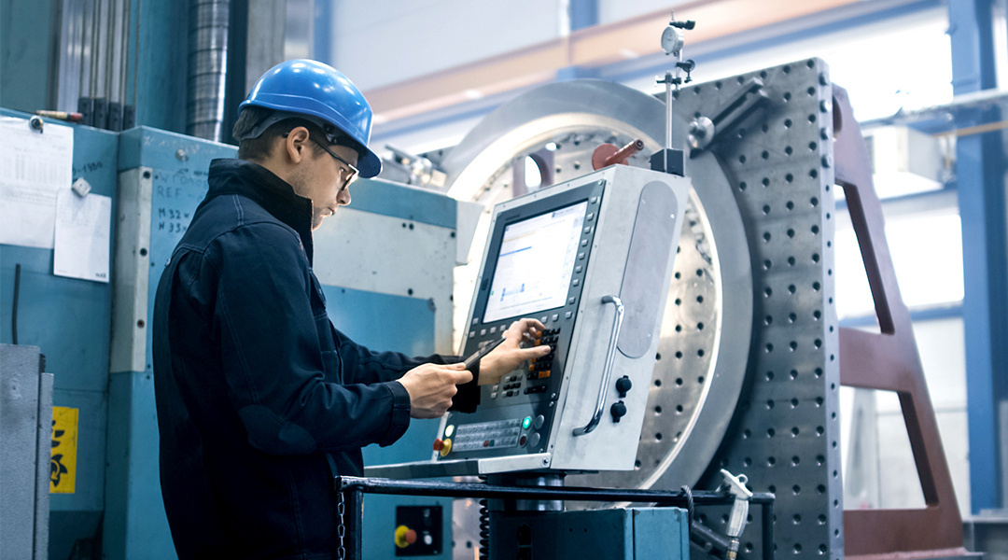
03
Problem Statement
Building a Machine Learning model which is developed on indusrty data, that can analyze a given set of features to predict maintenance period.
Introduction
Occurrences of maintenance periods in manufacturing industries were always a problem. Idle workers, increase in manufacturing time and cost, are its most common outcomes. But it can be solved by using machine learning techniques and algorithms

Slide 4
04
Goal 01
Objectives & Goals
Data Preprocessing: Process the data efficiently and logically, increasing model’s accuracy
Goals 02
Objectives
EDA: Exploraitory Data Analysis will help with feature extraction and selection.
The objective are as simple as to deliver a machine learning model with higher precision.
Goals 03
Model Selection: train and compare different ML models to achive higher precision value.

Slide 5

05
Importance of PdM
Reduce downtime
Improve equipment reliability
Increase machine lifespan
Reduce maintenance costs
Improve production efficiency
Create safer operating conditions

Slide 6





06
Timeline
Data Collection
Data Preprocessing
EDA
Model Selection
Model
Comparison

Slide 7
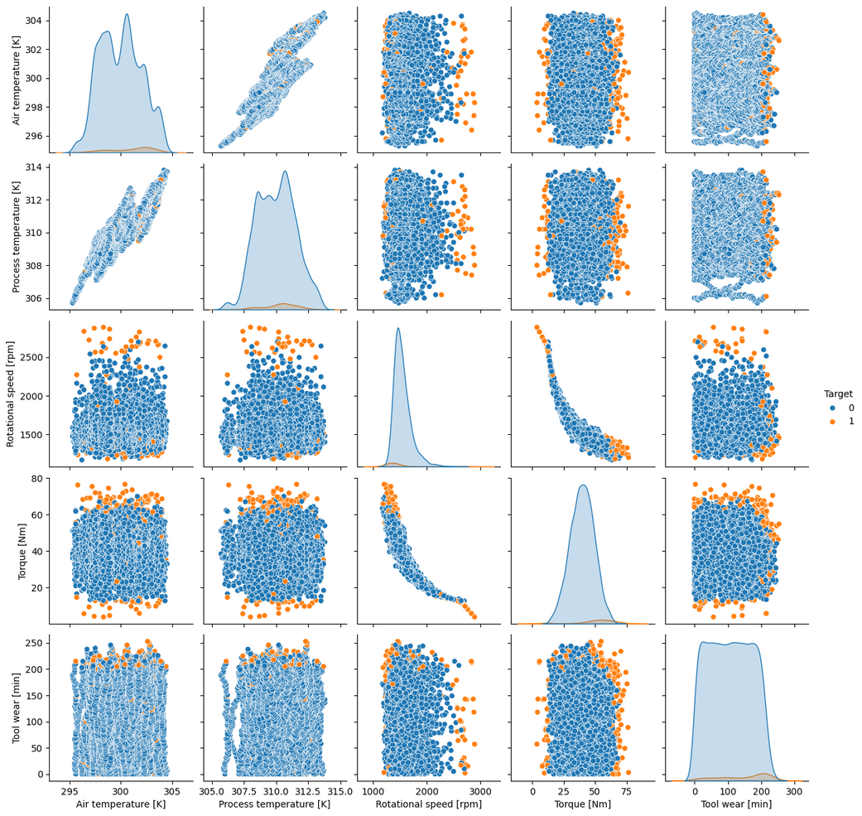
EDA
07
Findings
Torque vs [air, temprature, tool wear]
Air and Temprature’s maintenance period looks similar with period happening at start and end
The Tool Wear is happening generally when the torque is maximum
2. Rotational Speed
The Rotational Speed when increased along with Air and temprature the maintenance periods happenned quite often
The Rotation vs Torque results in maintenance period if (high rotation and low torque) or (low rotation with high torque) forming a curve shape
Relationship Matrix

Slide 8

08
Model Training
Random Forest Classifier
Logistic Regressor
Support Vector Classifier

Slide 9
09
Model Evaluation
Random Forest Classifier
Logistic Regressor
Support Vector Classifier
Accuracy: 0.98475
Precision: 0.9464285714
Recall: 0.6883116883
F1-Score: 0.7969924812
Accuracy: 0.96875
Precision: 1.0
Recall: 0.1688311688
F1-Score: 0.288888888
Accuracy: 0.9615
Precision: 0.43000025
Recall: 0.22254932
F1-Score: 0.665326544

Slide 10
10
Conclusion
The machine learning model is achieved with a total of 94% of precision. The Random Forest Classifier has been found useful as the data can be distributed in a data pattern. The key findings of EDA helped us in deriving the nature of the maintenance pattern. Later this model, or industry specific model can be made to attain the task of predicting maintenance. This model is just an example on how machine learning can be used in every thing from day to day life to manufacturing world.

Slide 11
11
Thank You
github.com/Manish-128
7743918224
Mowad, Nagpur

